Slide 1

Sales Performance & Revenue Forecast – FY 2025
Driving Growth Through Data-Driven Insights & Strategic Execution

Slide 2
Agenda and Overview
Agenda
Revenue Forecasting
Sales Performance
Geographic Analysis
Pipeline Health
Overview
• Executive Summary
Key performance highlights and strategic takeaways
• Revenue Performance
Total, actual, and forecasted revenue trends across years and quarters
• Monthly Profit Patterns
Seasonal spikes and micro-trends driving quarterly highs
• Sales Funnel & Conversion Analysis
Win rates, deal sizes, and funnel stage breakdowns
• Departmental Performance
Revenue and loss insights across business units
• Regional & Global Trends
Top-performing regions and countries with opportunity distribution
• Category-Specific Insights
Furniture, Office Supplies, and Technology performance cycles
• Pipeline Health & Forecast Accuracy
Opportunity flow, deal closure speed, and predictive reliability
• Strategic Recommendations
Actionable insights to improve forecasting, conversion, and planning

Slide 3
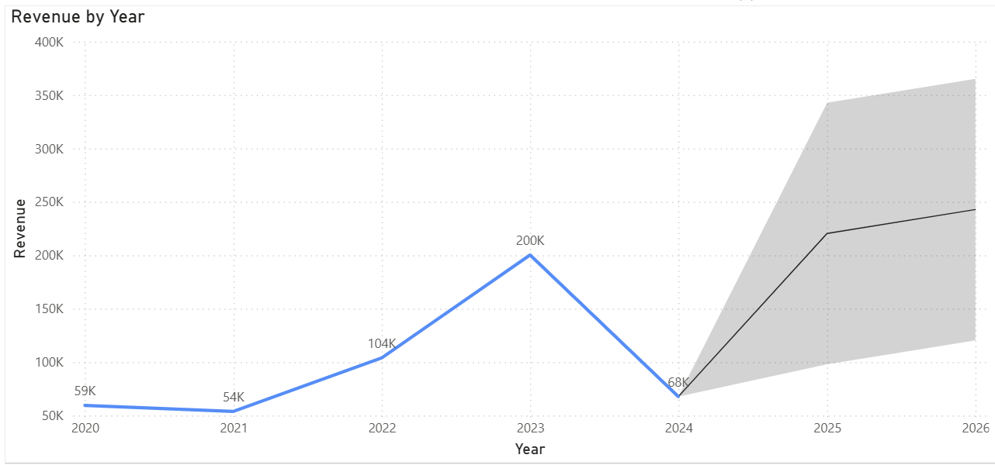
Yearly Growth Trends (2020–2024): From Disruption to Resilience
Yearly Growth Trends (2020–2024)
Revenue has shown volatility but positive long-term growth trajectory.
Q3 and September emerge as critical revenue periods for planning and resource allocation.
Forecast accuracy improvements are essential for more reliable financial planning.
Monitoring weighted revenue trends can enhance sales efficiency and budget alignment.
Revenue Growth Projection
The forecast data shows an expected increase in revenue for the year 2025, with a forecasted revenue of $260.87K.
There is a strong quarterly distribution, with the third quarter having the highest weighted amount.
Monthly data indicates a peak in September for weighted revenue.
Forecast accuracy is relatively low (18.20%), suggesting some variability or uncertainty in the forecast.
The average probability of forecast success is around 59.93%.

Slide 4
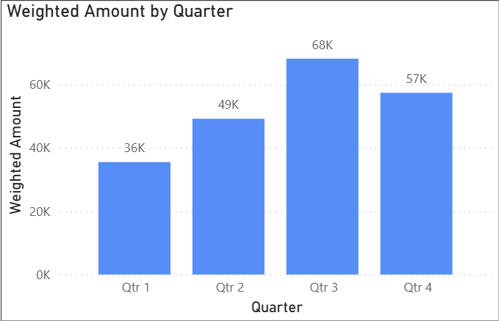
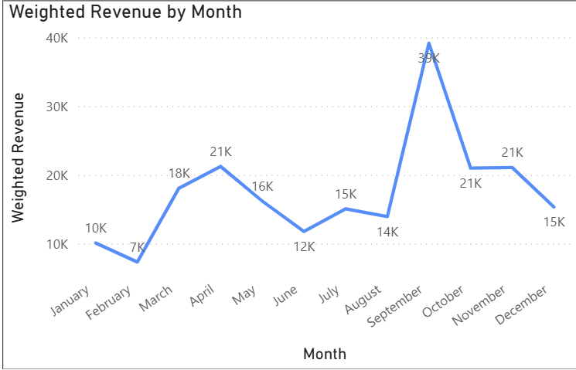
Revenue Optimization Strategies
Strategies for Improvement
Boost Weighted Revenue
Focus on high-value opportunities with moderate to high probability.
Reallocate resources to maximize weighted revenue potential.
Capitalize on Seasonal Trends
Plan marketing campaigns and product launches around peak months (e.g., September).
Leverage Q3 trends to enhance promotions and sales initiatives.
Expand in High-Performing Regions and Categories
Analyze regional and category performance to target high-growth areas.
Tailor strategies using regional insights (Asia, Europe, Middle East, etc.).
Address Revenue Fluctuations
Investigate causes of yearly dips and implement corrective measures.
Maintain balanced efforts across quarters and months to stabilize revenue.
Increase Actual Revenue Capture
Strengthen follow-up strategies and closing techniques to convert opportunities.
Reduce potential revenue leaks through better pipeline management.
Improve Data Granularity and Tracking
Track weighted revenue by month and quarter for more granular insights.
Implement real-time dashboards and alerts to monitor revenue performance.

Slide 5
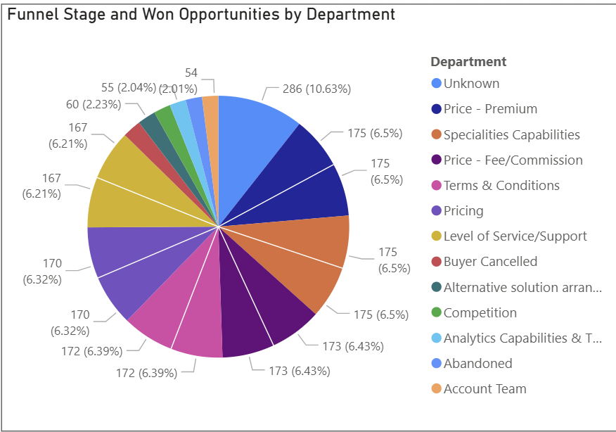
Sales Trends & Performance Across Departments
Sales Performance Insights
Win Rate: The company sustains a 62%-win rate, with won revenue slightly exceeding lost value — indicating balanced sales effectiveness.
Top-Performing Departments: Strong performance in Service Levels, Specialties, Pricing, and Terms & Conditions, driving most successful deals.
Key Challenges: Major contributors to lost value include Competition and Buyer Cancellations, signaling areas for strategic improvement.
Funnel Analysis: A robust pipeline exists at early and mid funnel stages, though conversion can improve for Sold Not Booked and Unsuccessful opportunities.
Actionable Focus: Strengthen late-stage deal management and refine win-back strategies for lost opportunities.

Slide 6
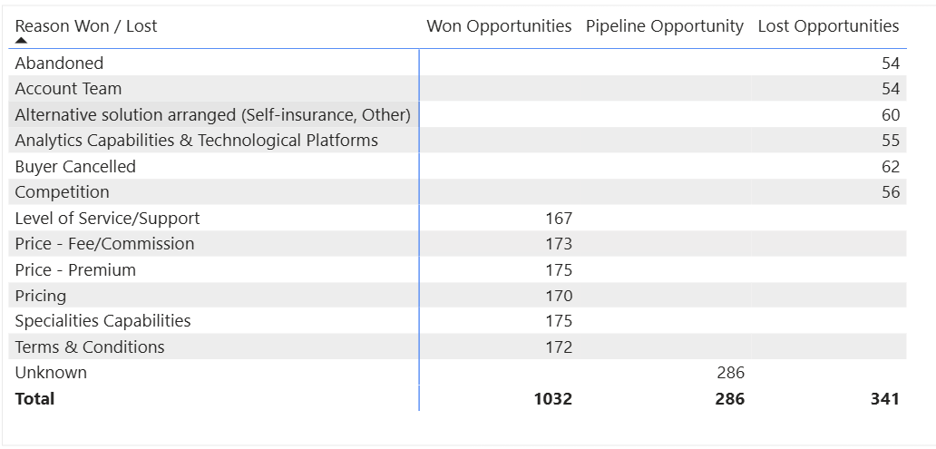
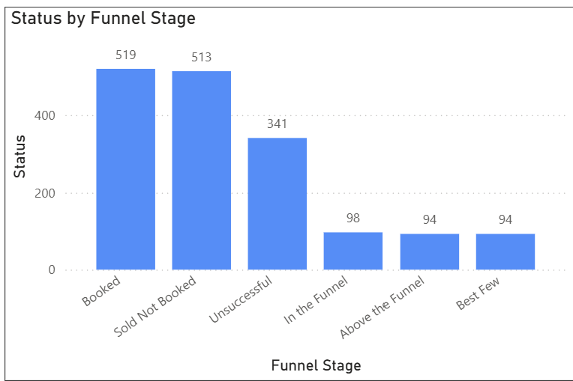
Key Strategies to Boost Sales Performance
Strategies for Improvement
Enhance Late-Stage Conversions: Implement targeted follow-ups and personalized offers to recover “Sold Not Booked” and “Unsuccessful” deals.
Competitive Intelligence: Strengthen win–loss analysis to identify competitor pricing, service gaps, and differentiators.
Buyer Retention Programs: Reduce cancellations through proactive engagement, improved onboarding, and loyalty initiatives.
Sales Enablement: Provide training and data-driven insights to help teams close complex, high-value opportunities faster.
Pipeline Optimization: Prioritize high-probability deals and automate lead scoring to focus resources efficiently.
Cross-Department Collaboration: Align service, pricing, and account teams for consistent customer experience across the funnel.
Performance Monitoring: Use dashboards to track stage-wise conversion rates and set measurable improvement goals.

Slide 7
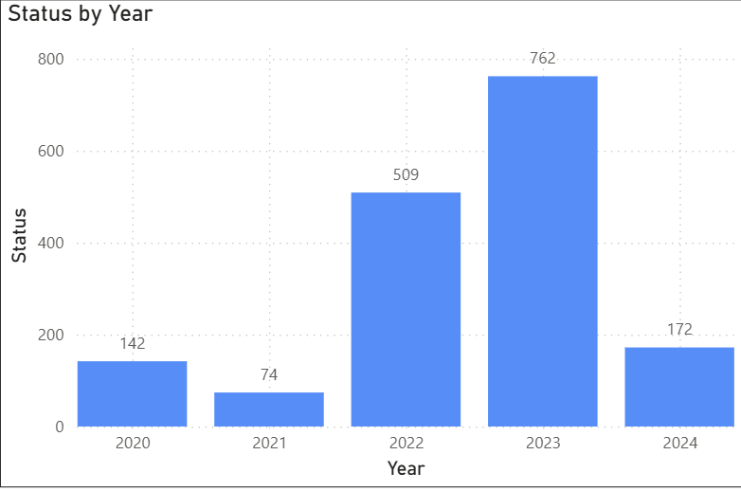
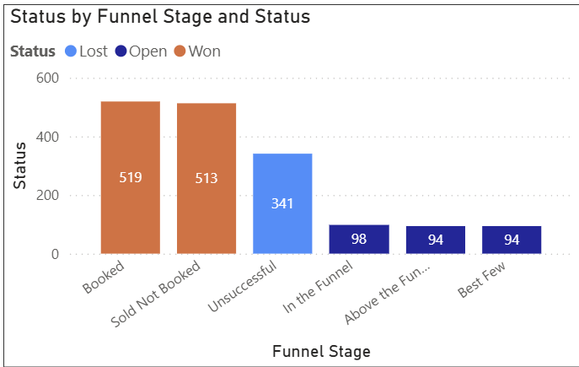
Sales Pipeline Performance Insights (2020–2024)
Sales Pipeline Performance Insights
Steady Growth with 2023 Peak: Pipeline activity rose sharply in 2022–2023 (143 deals in 2023) before a slowdown in 2024, indicating potential resource or market constraints.
Efficiency Metrics: Average 3.35 days to close suggests efficient turnaround, especially for short-cycle opportunities.
Healthy Pipeline: The sales pipeline remains strong, with a high total value and a short average closing time, reflecting operational efficiency.
Recent Growth Momentum: The majority of deals and wins are concentrated in 2022–2023, marking a peak in opportunity generation and conversion.
Regional Performance: Asia and Pacific regions lead in won opportunities, highlighting strong market traction and execution effectiveness.
Conversion Focus: Attention should be directed toward “Open” and “Best Few” stages to reduce losses and improve late-stage deal conversions.
Strategic Opportunity: Strengthening the Best Few stage can significantly uplift overall win rates and revenue outcomes.

Slide 8
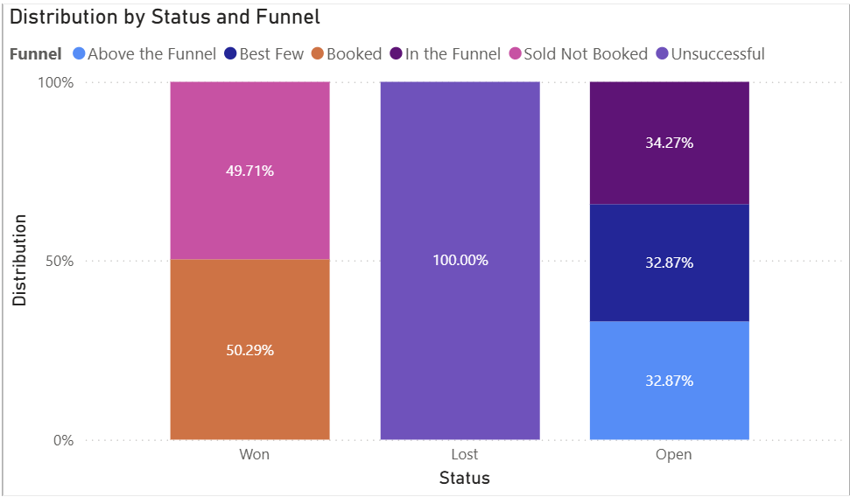
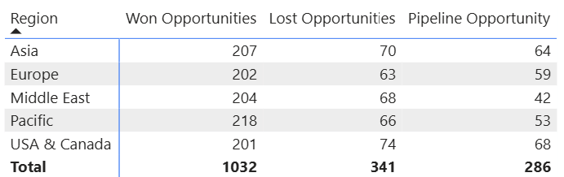
Key Strategies for Pipeline Optimization
Strategies for Pipeline Optimization
Strengthen Mid-to-Late Funnel Conversion
Identify drop-off points between “Sold Not Booked” and “Unsuccessful.”
Deploy sales playbooks and deal review checkpoints for critical opportunities.
Regional Tailoring & Focus
Replicate Asia-Pacific best practices (pricing, engagement, or product bundling) in underperforming regions like USA & Canada.
Introduce localized offers or faster response models to counter regional competition.
Opportunity Quality & Forecasting
Implement lead scoring to prioritize high-probability deals.
Refine forecasting accuracy using expected close date trends and pipeline aging metrics.
Data-Driven Sales Coaching
Use dashboard insights to coach reps on deal pacing, conversion tactics, and objection handling.
Reduce Lost Opportunities
Conduct win–loss analyses to understand patterns behind buyer cancellations and competition-led losses.
Design win-back campaigns targeting high-value lost deals.
Enhance Early Funnel Efficiency
Automate qualification and nurture low-touch leads to maintain healthy inflow without overburdening sales teams.

Slide 9
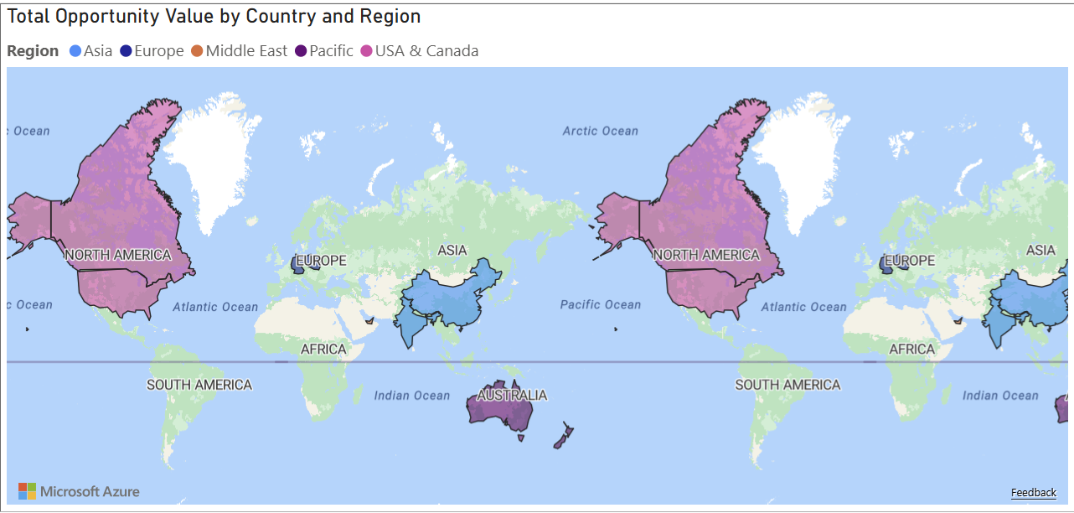
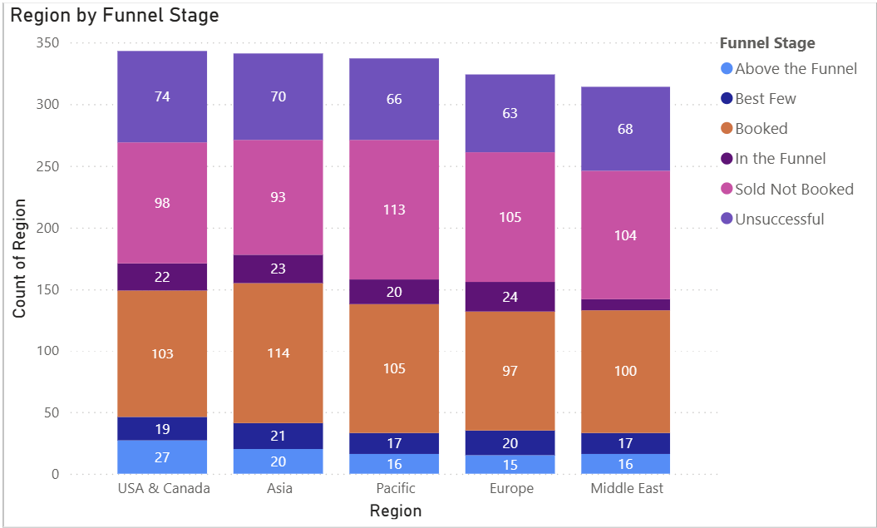
Regional Performance & Growth Insights
Regional Performance Insights
Asia (led by China) is the top-performing region, excelling in both total revenue and funnel activity.
The Pacific region also demonstrates strong funnel performance and consistent deal flow.
USA & Canada and Europe show lower revenues and smaller funnel volumes, revealing growth potential.
The company should sustain momentum in Asia-Pacific while developing targeted strategies to improve performance in other regions.
Middle East shows a moderate funnel stage activity with potential to grow, especially by focusing on the "Booked" and "Sold Not Booked" stages.
The "Unsuccessful" funnel counts are relatively low across all regions, indicating efficient funnel management but also opportunities to convert some of the "Sold Not Booked" leads into revenue.

Slide 10
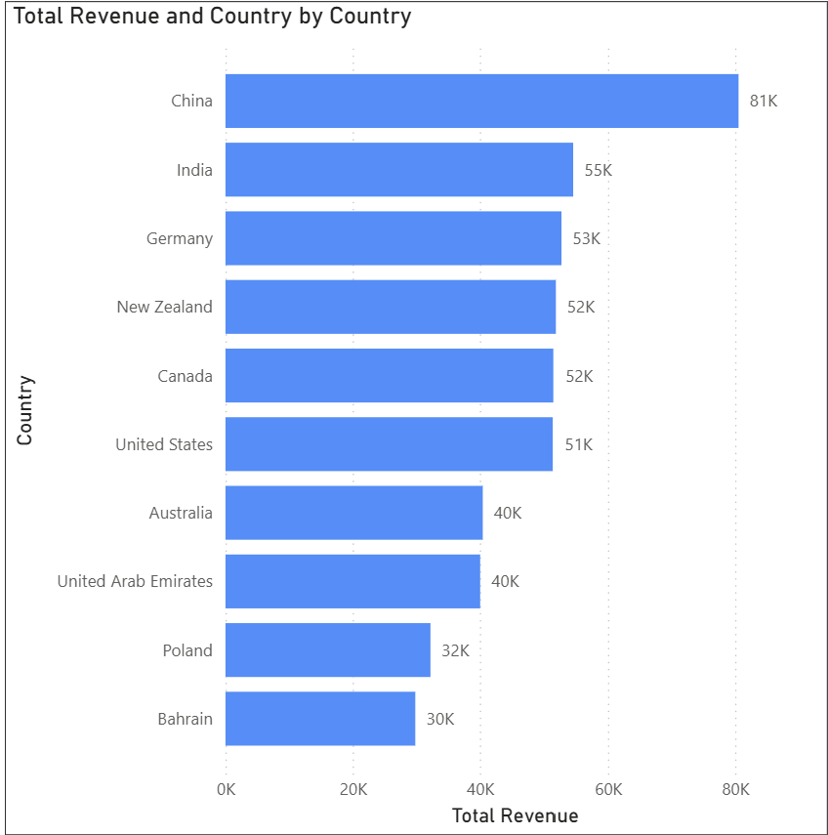
Strategies For Growth Across Key Global Regions
Regional Growth Strategies
Strengthen Leadership in Asia-Pacific
Continue investing in high-performing markets (China, New Zealand, India).
Expand partnerships and product offerings in emerging Asian economies.
Localize marketing to deepen regional brand presence.
Revitalize USA & Europe Performance
Conduct market gap analysis to identify pricing or service limitations.
Introduce region-specific promotions or bundled offerings.
Improve sales enablement and client engagement for competitive differentiation.
Optimize Funnel Conversion Across Regions
Monitor “Sold Not Booked” and late-stage deal drop-offs to recover potential wins.
Roll out regional sales strategies designed to align with customer buying patterns.
Leverage Data-Driven Insights
Use dashboard analytics to track regional conversion rates, deal velocity, and revenue per opportunity.
Prioritize high-potential regions with scalable ROI.
Balanced Global Expansion
Maintain Asia-Pacific as the growth anchor, while strategically investing in underpenetrated markets to ensure global stability.

Slide 11
Conclusion and Summary
Key Takeaways & Strategic Next Steps
Revenue Outlook: FY 2025 forecast at $260.87K, with Q3 and September as peak periods.
Sales Efficiency: 62% win rate, strong departmental performance, but late-stage conversion needs attention.
Regional Focus: Asia-Pacific leads growth; USA, Europe, and Middle East offer untapped potential.
Pipeline Health: Fast deal closure (avg. 3.35 days), but “Sold Not Booked” stage needs strategic recovery.
Action Plan:
Boost weighted revenue via high-probability deals
Strengthen competitive intelligence and buyer retention
Localize regional strategies and replicate best practices
Enhance forecasting accuracy and dashboard tracking

Slide 12
Thank you for your time. Looking forward to driving growth together!

